Slide 1
Predicting Credit Card Default
With Guan Chen

Slide 2
Research Question
1
What factors play the biggest role in credit card default?

Slide 3
Relevance
American household debt is at an ATH
High chance of recession this year

Slide 4
Significance
Default of Credit Card Client Dataset
3 Variables over 6 months:
Repayment Status
Statement Amount
Payment Amount
Demographic Data
Sex
Education
Marriage
I Will Explore Two New Methods
XGBoost
Random Forest Classifier

Slide 5
Methods
Exploratory Data Analysis
Hyperparameter Optimization
Model Evaluation
1
3
5
2
4
Preprocessing and Feature Engineering
Model Fitting

Slide 6

Dataset EDA
Sample Size
Imbalanced Dataset
Age Distribution
Marriage Distribution
Sex
Distribution
30,000 total samples
Only 22% of the dataset are defaults
Matches the general population
An almost even split of married vs single
60% of the samples are female

Slide 7
Feature Engineering
Credit Utilization
Average statement divided by credit limit
Late Payments
Number of delinquent repayment statuses
Spending Volatility
Variance of statement balances

Slide 8
Preprocessing
Encoding
Binary encoded Sex
Ordinal encoded Education
One-hot encoded Marriage
Standardization
Transform numerical data to have:
Mean = 0
Std Dev = 1
Split
60 – 20 – 20 Split for training, validation, and testing

Slide 9
Hyperparameter Optimization
Random Forest
Number of estimators
Criterion for Splitting
Min Samples per Leaf
Min Samples per Split
Max Tree Depth
XGBoost
Number of estimators
Learning Rate
Max Tree Depth
Regularization parameters
(alpha, gamma, lambda)
Max Delta Step
Min Child Weight

Slide 10
Results
Model | Precision | Recall | AUC
Default Forest | 0.65 | 0.37 | 0.76
AUC Forest | 0.70 | 0.36 | 0.79
F1 Forest | 0.70 | 0.36 | 0.79
Basic XGBoost | 0.62 | 0.37 | 0.75
AUC XGBoost | 0.71 | 0.35 | 0.79
AUC XGBoost No Regularization | 0.59 | 0.38 | 0.74

Slide 11
How Does It Match Up?

Slide 12
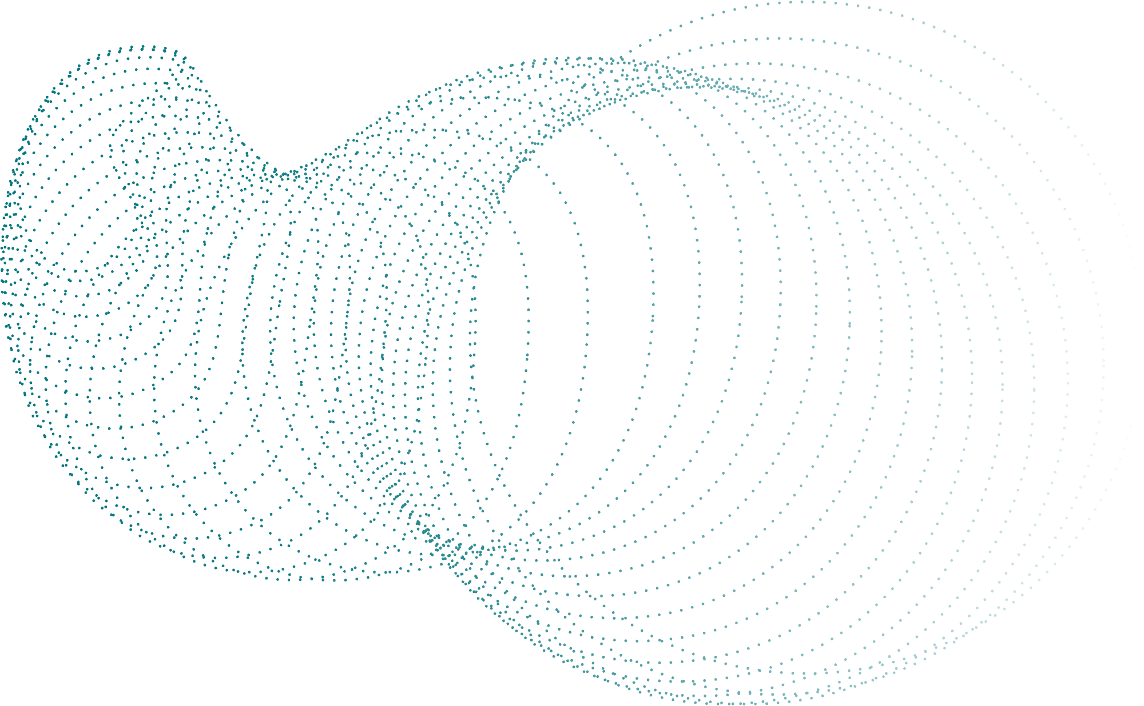
Feature 1:
Repayment Status 1
Feature 2: Late Payment Count
Feature Importances
Repayment status in September, 2005
Number of times delinquent
Most features had low correlations to default except . . .

Slide 13
Conclusion
2

Slide 14
Thank You!

Slide 15
Works Cited
“Household Debt and Credit Report.” n.d. Accessed April 19, 2025. https://www.newyorkfed.org/microeconomics/hhdc.
Jose, Joel, and Siddarth S. 2025. “Goldman Raises Odds of US Recession to 35%​.” Reuters, March 31, 2025, sec. U.S. Markets. https://www.reuters.com/markets/us/goldman-sachs-expects-us-fed-deliver-three-rate-cuts-2025-2025-03-31/.
News, A. B. C. n.d. “Americans’ Credit Card Debt Reaches New Record High: New York Federal Reserve.” ABC News. Accessed April 19, 2025. https://abcnews.go.com/Business/americans-credit-card-debt-reaches-new-record-high/story?id=118788620.
“What Is the Probability of a Recession? | J.P. Morgan Research.” n.d. Accessed April 19, 2025. https://www.jpmorgan.com/insights/global-research/economy/recession-probability.
Yeh, I-Cheng, and Che-hui Lien. 2009. “The Comparisons of Data Mining Techniques for the Predictive Accuracy of Probability of Default of Credit Card Clients.” Expert Systems with Applications 36 (2, Part 1): 2473–80. https://doi.org/10.1016/j.eswa.2007.12.020.

